Slide 1


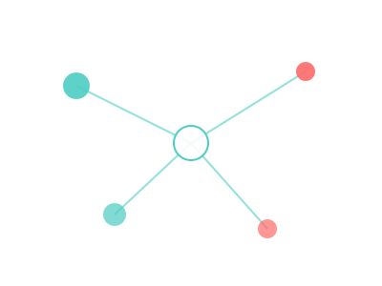

Rethinking
Collaborative
Development
A live case study: from ambiguous ideas to mission-aligned execution
Keenan Thompson
CEO, Arcnem AI • arcnem.ai
Paul Consalvi
Professor, The University of Tokyo, Graduate School of Frontier Sciences

Slide 2



Where collaboration breaks
Credit without accountability
Great ideas die early
Human translation loss
Invisible labor, hierarchy capture, authorship politics
No durable bridge from insight to execution
Meaning shifts between "idea language" and "build language"

Slide 3

How we actually worked
Paul - Critical thinking lead
Keenan - Engineering lead
Vision, philosophy, and standards
Wrote ideas into concrete documents
Challenged assumptions and framing
Defined what "meaningful collaboration" means
System design and implementation
Asked clarifying questions constantly
Converted principles into product behavior
Used AI agents heavily, with review
This workflow became the product pattern.

Slide 4

Communication is lossy
Paul's
vision
His
words
Keenan's
picture
Clarifying
questions
Written
context
The fix: write it down
I asked Paul to write down his vision. That document became shared context for me and for AI agents. His aspiration lives in the codebase alongside the code.

Slide 5




Compound Engineering
Turn each conversation into reusable execution context
Brainstorm
Plan
Work
Surface ambiguity before touching code
Research the codebase, docs, and constraints
Build with AI agents, guided by human judgment
Review
Compound
Multi-angle review for quality, security, and drift
Capture decisions so the next cycle starts smarter
The repo becomes institutional memory, not just source files.

Slide 6

The product mirror
Our collaboration pattern maps directly to Collabojin
In this partnership
In the platform
Vague intent in one person's head
=
Initiative pipeline with explicit scoping
Clarifying dialogue before implementation
=
Onboarding friction to align on why
Written context and shared memory
=
Contribution logs and transparent audit trails

Slide 7

Collabojin principles
Stewardship over status
Intentional friction
Transparent credit
Slow down just enough to align on purpose.
Authorship is earned through visible contribution.
Roles, not ranks
Anti-rent-seeking
A student can steward; a professor can contribute.
The system resists credit capture by design.

Slide 8

Why familiar tools mattered
Known stack + known patterns = better AI outcomes
Bun
React
Drizzle
PostgreSQL
Railway
Inngest
Faster error detection
You notice agent drift because patterns are familiar
Tighter iteration loops
Time goes to problem-solving, not tool-learning
Context compounds
AGENTS.md + vision docs + logs improve every session

Slide 9
From vague to concrete
Ambiguity -> alignment -> execution -> compounding
01
Aspiration
Critical-thinking vision for better collaboration
02
Dialogue
Clarifying questions expose hidden assumptions
03
Written context
Shared documents align humans and AI
04
AI-augmented build
Compound workflow turns context into working software
05
Learning compounds
Each cycle reduces rework and raises quality

Slide 10
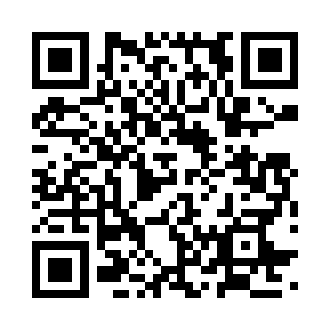
Collaboration is a
design problem.
Better systems, better questions, better shared memory.
Keenan Thompson
CEO, Arcnem AI • arcnem.ai
Paul Consalvi
Professor, The University of Tokyo, Graduate School of Frontier Sciences
Tokyo Tech Talks #1 • February 22, 2026 • UTokyo Kashiwa
tokyotechtalks.com

